Slide 1
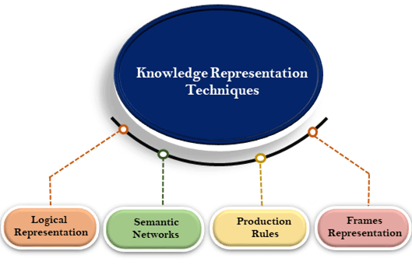
Techniques of knowledge representation
There are mainly four ways of knowledge representation which are given as follows:
Logical Representation
Semantic Network Representation
Frame Representation
Production Rules

Slide 2
Logical Representation
Logical representation is a language with some concrete rules which deals with propositions and has no ambiguity in representation. Logical representation means drawing a conclusion based on various conditions.
This representation lays down some important communication rules. It consists of precisely defined syntax and semantics which supports the sound inference. Each sentence can be translated into logics using syntax and semantics.
Syntax:
Syntaxes are the rules which decide how we can construct legal sentences in the logic.
It determines which symbol we can use in knowledge representation.
How to write those symbols.
Semantics:
Semantics are the rules by which we can interpret the sentence in the logic.
Semantic also involves assigning a meaning to each sentence.

Slide 3
Propositional logic
Propositional logic (PL) is the simplest form of logic where all the statements are made by propositions. A proposition is a declarative statement which is either true or false. It is a technique of knowledge representation in logical and mathematical form.
Example:
a) It is Sunday.
b) The Sun rises from West (False proposition)
c) 3+3= 7(False proposition)
d) 5 is a prime number.

Slide 4
Some basic facts about propositional logic:
Propositional logic is also called Boolean logic as it works on 0 and 1.
In propositional logic, we use symbolic variables to represent the logic, and we can use any symbol for a representing a proposition, such A, B, C, P, Q, R, etc.
Propositions can be either true or false, but it cannot be both.
Propositional logic consists of an object, relations or function, and logical connectives.
These connectives are also called logical operators.
The propositions and connectives are the basic elements of the propositional logic.
Connectives can be said as a logical operator which connects two sentences.
A proposition formula which is always true is called tautology, and it is also called a valid sentence.
A proposition formula which is always false is called Contradiction.
Statements which are questions, commands, or opinions are not propositions such as "Where is Rohini", "How are you", "What is your name", are not propositions.

Slide 5
Syntax of propositional logic:
The syntax of propositional logic defines the allowable sentences for the knowledge representation. There are two types of Propositions:
Atomic Propositions
Compound propositions
Atomic Proposition: Atomic propositions are the simple propositions. It consists of a single proposition symbol. These are the sentences which must be either true or false.
a) 2+2 is 4, it is an atomic proposition as it is a true fact.
b) "The Sun is cold" is also a proposition as it is a false fact.

Slide 6
Compound proposition: Compound propositions are constructed by combining simpler or atomic propositions, using parenthesis and logical connectives.
Example:
a) "It is raining today, and street is wet."
b) "Ankit is a doctor, and his clinic is in Mumbai."

Slide 7
Logical Connectives:
Logical connectives are used to connect two simpler propositions or representing a sentence logically. We can create compound propositions with the help of logical connectives. There are mainly five connectives, which are given as follows:
Negation: A sentence such as ¬ P is called negation of P. A literal can be either Positive literal or negative literal.
Conjunction: A sentence which has ∧ connective such as, P ∧ Q is called a conjunction. Example: Rohan is intelligent and hardworking. It can be written as,
P= Rohan is intelligent, Q= Rohan is hardworking. → P∧ Q.
Disjunction: A sentence which has ∨ connective, such as P ∨ Q. is called disjunction, where P and Q are the propositions. Example: "Ritika is a doctor or Engineer", Here P= Ritika is Doctor. Q= Ritika is Doctor, so we can write it as P ∨ Q.

Slide 8
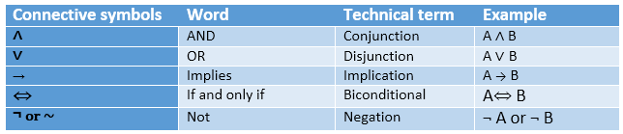
Implication: A sentence such as P → Q, is called an implication. Implications are also known as if-then rules. It can be represented as If it is raining, then the street is wet. Let P= It is raining, and Q= Street is wet, so it is represented as P → Q
Biconditional: A sentence such as P⇔ Q is a Biconditional sentence, example If I am breathing, then I am alive P= I am breathing, Q= I am alive, it can be represented as P ⇔ Q.

Slide 9
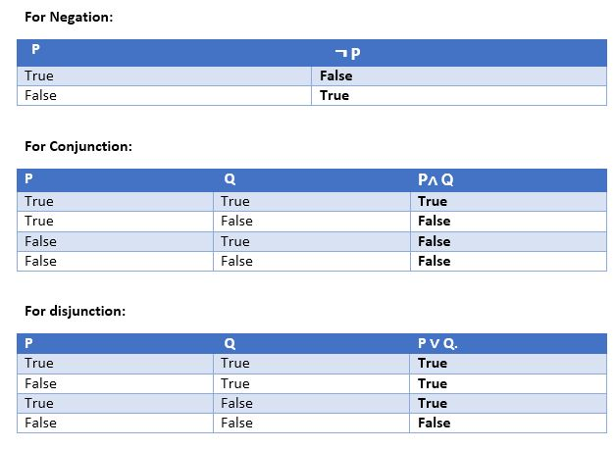

Slide 10
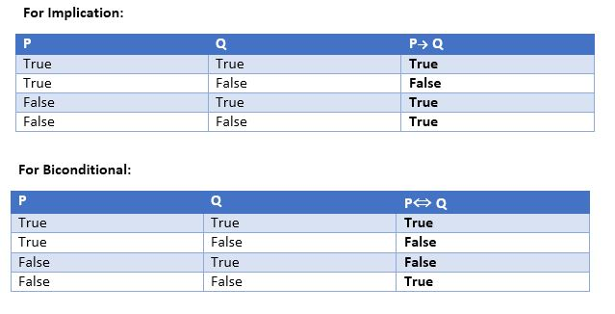

Slide 11
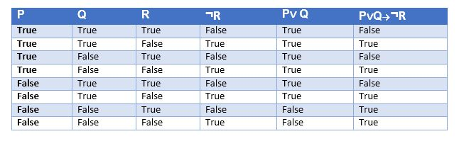
Truth table with three propositions:
We can build a proposition composing three propositions P, Q, and R. This truth table is made-up of 8n Tuples as we have taken three proposition symbols.

Slide 12
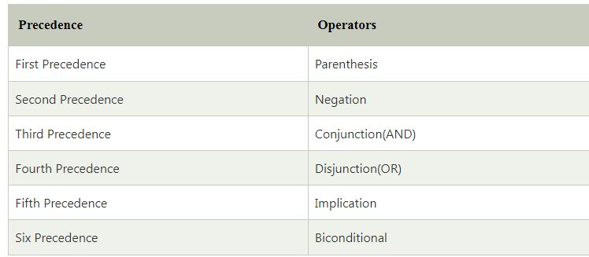
Precedence of connectives:
Just like arithmetic operators, there is a precedence order for propositional connectors or logical operators. This order should be followed while evaluating a propositional problem. Following is the list of the precedence order for operators:

Slide 13
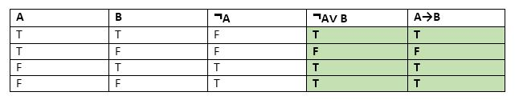
Logical equivalence:
Logical equivalence is one of the features of propositional logic. Two propositions are said to be logically equivalent if and only if the columns in the truth table are identical to each other.
Let's take two propositions A and B, so for logical equivalence, we can write it as A⇔B. In below truth table we can see that column for ¬A∨ B and A→B, are identical hence A is Equivalent to B

Slide 14
Properties of Operators:
Commutativity:
P∧ Q= Q ∧ P, or
P ∨ Q = Q ∨ P.
Associativity:
(P ∧ Q) ∧ R= P ∧ (Q ∧ R),
(P ∨ Q) ∨ R= P ∨ (Q ∨ R)
Identity element:
P ∧ True = P,
P ∨ True= True.
Distributive:
P∧ (Q ∨ R) = (P ∧ Q) ∨ (P ∧ R).
P ∨ (Q ∧ R) = (P ∨ Q) ∧ (P ∨ R).
DE Morgan's Law:
¬ (P ∧ Q) = (¬P) ∨ (¬Q)
¬ (P ∨ Q) = (¬ P) ∧ (¬Q).
Double-negation elimination:
¬ (¬P) = P.

Slide 15
Limitations of Propositional logic:
We cannot represent relations like ALL, some, or none with propositional logic.
Example:
All the girls are intelligent.
Some apples are sweet.
Propositional logic has limited expressive power.
In propositional logic, we cannot describe statements in terms of their properties or logical relationships.

